Slide 1
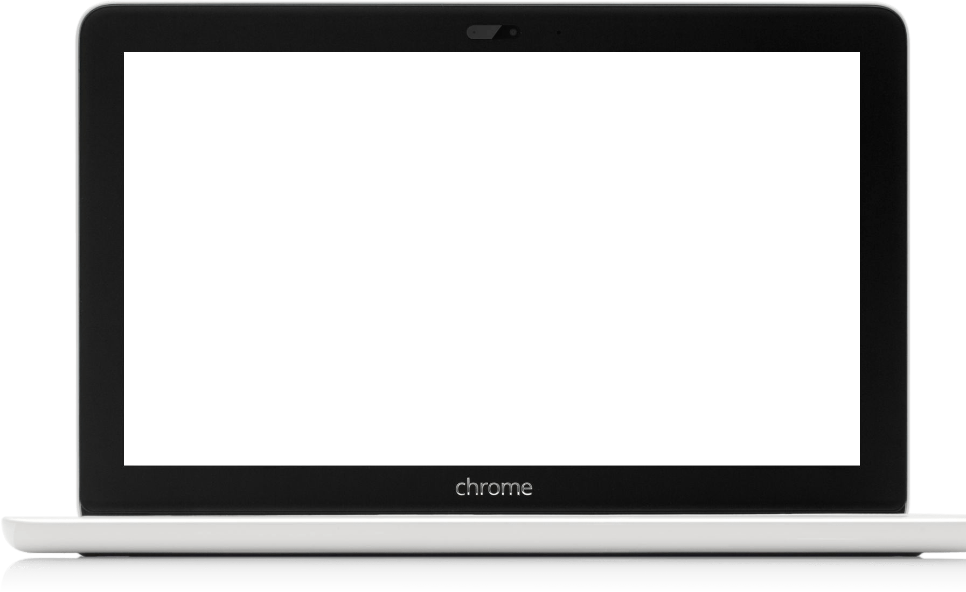
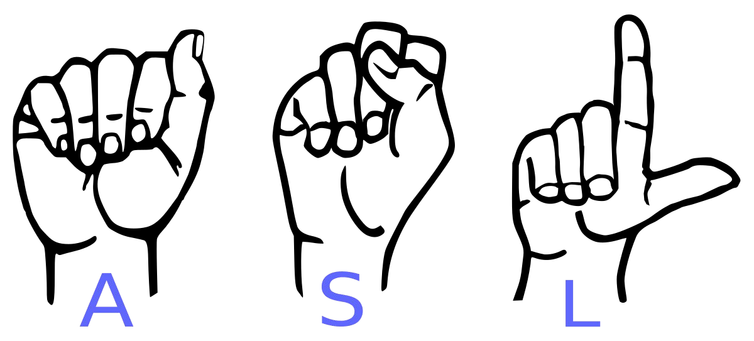
Conversion of Sign Language to Text
For Dumb and Deaf
*not for Blind

Slide 2

Efforts by
Project Under Supervision of
Mr. Sumit Bagchi
Shubhadeep Chakraborty
&
Sourav Dhali

Slide 3

Introduction.
Motivation
A person with speaking disorders face major problems of expressing their emotions as freely in this world.
“Not able to utilize” some of the new technologies.

Slide 4
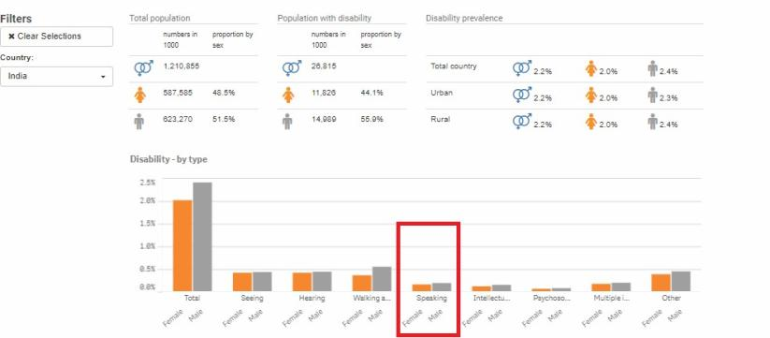
Statistics retrieved from
United Nation Statistics Division

Slide 5
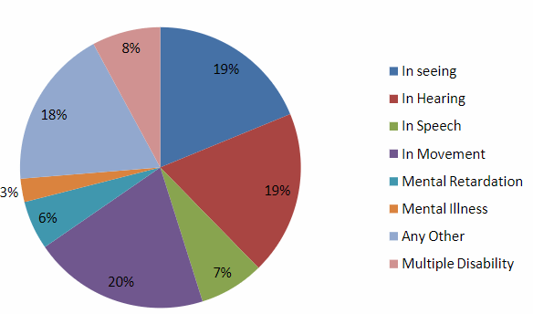
Disabled population by type of disability in India census 2011

Slide 6
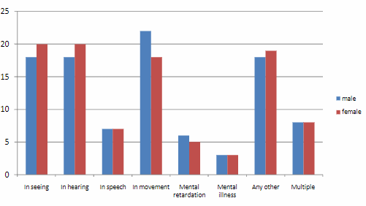
Distribution disabled person by sex and by type of disability (%) in India Census 2011

Slide 7
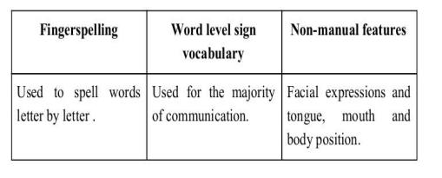
Abstract
Our project aims to create a computer application and train a model which when shown a real time video of hand gestures of American Sign Language shows the output for that particular sign in text format on the screen.
Sign language is a visual language and consists of 3 major components:

Slide 8
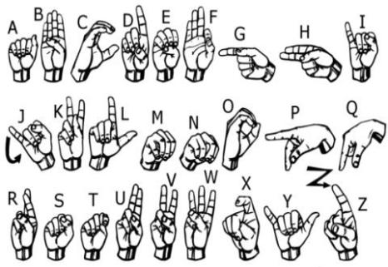
We implemented 20 symbol(A,B,C,D,E,F,G,I,K,L,O,P,Q,W,X,Y,Like,Dislike,
Rocking,Thank you) of ASL
in our project.

Slide 9




Technologies Used
Python 3.11.
TensorFlow framework, Keras model
Real-time computer vision using OpenCV

Slide 10
Challenges Faced
We couldn’t find a dataset with raw images of all the asl characters so we made our own dataset.
Issues were faced relating to the accuracy of the model we trained in earlier phases which we eventually improved by increasing the input image size and also by improving the dataset.

Slide 11
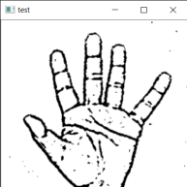
Layer 1
Gesture Classification
Layer 2
Classify between Similar Symbols
Classify between
20
Symbols

Slide 12
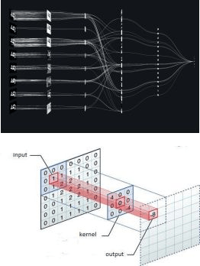
Convolutional Neural Networks
CNNs consist of multiple convolutional layers each layer containing numerous “filters” which perform feature extraction.
It’s primarily used for image classification.
For more information :-
https://towardsdatascience.com/using-convolutional-neural-network-for-image-classification-5997bfd0ede4

Slide 13
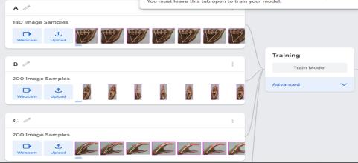
Implementation
After collecting hand data we trained our data in google teachable machine and take our keras model.
Then we create the all alphabet array and classify the model with program.
The model take the image input and predict the accuracy and which alphabet accuracy in high show the output of this alphabet.

Slide 14
Core Modules
Data Pre-Processing
Hand tracking on camera
Make a image of only hand
Scan the sign with trained model
Give the output of the scan on screen

Slide 15
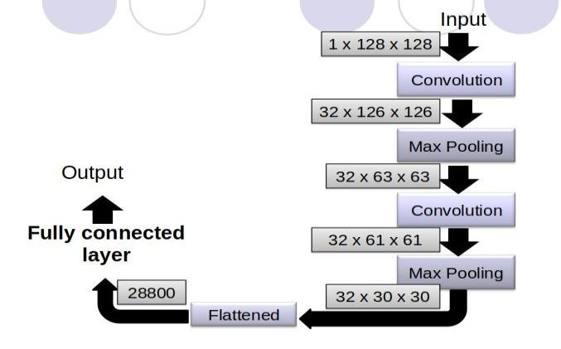
Our Classifier Model

Slide 16
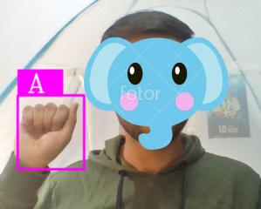
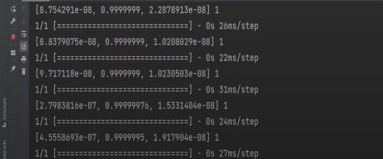
Conclusion
In this report, a functional real time vision based american sign language recognition for D&M people have been developed for asl alphabets.
We achieved an accuracy of 90% on our dataset.

Slide 17
Future Scope
We are planning to achieve higher accuracy even in case of complex backgrounds by trying out various background.
We are also thinking of improving the preprocessing to predict gestures in low light conditions with a higher accuracy.
We are thinking to add more alphabet and signs to improve communication.

Slide 18
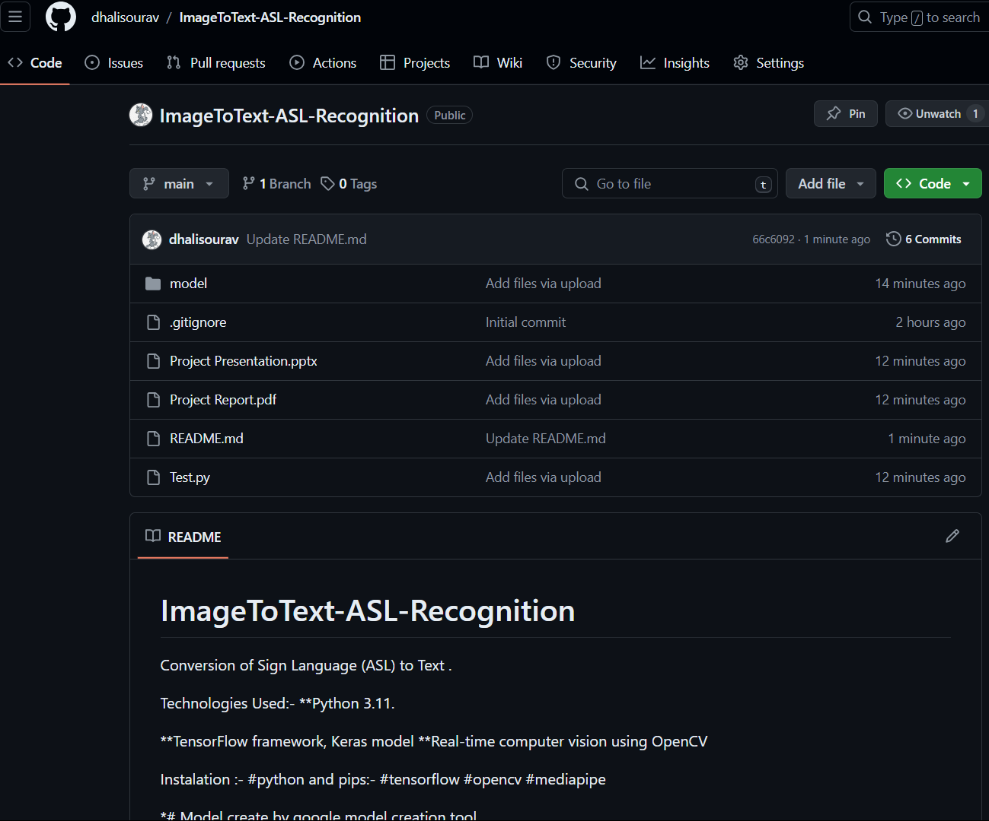
You can find this project in :-
https://github.com/dhalisourav/ImageToText-ASL-Recognition

Slide 19
Thank You :)

